Slide 1
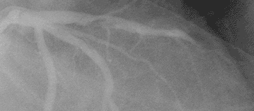



CARDIOPATIA ISQUEMICA ESTABLE
SCASEST (Síndrome Coronario Agudo sin Elevación del ST)
Lorenzo Silva Melchor
Unidad Coronaria
Hospital Puerta de Hierro-Majadahonda
Madrid

Slide 2
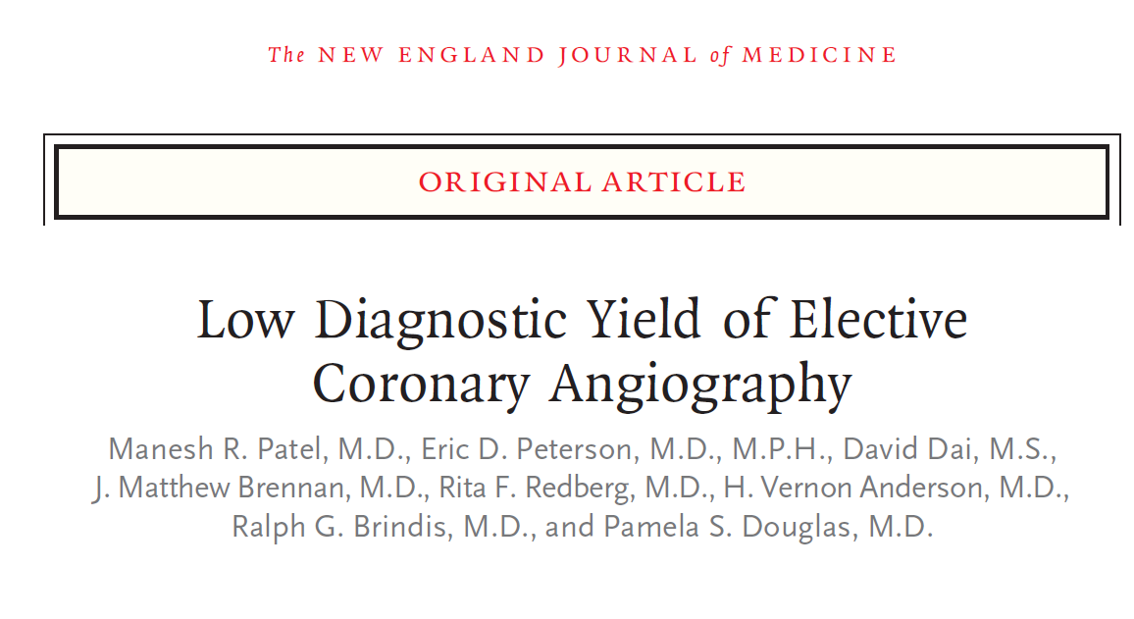


Slide 3
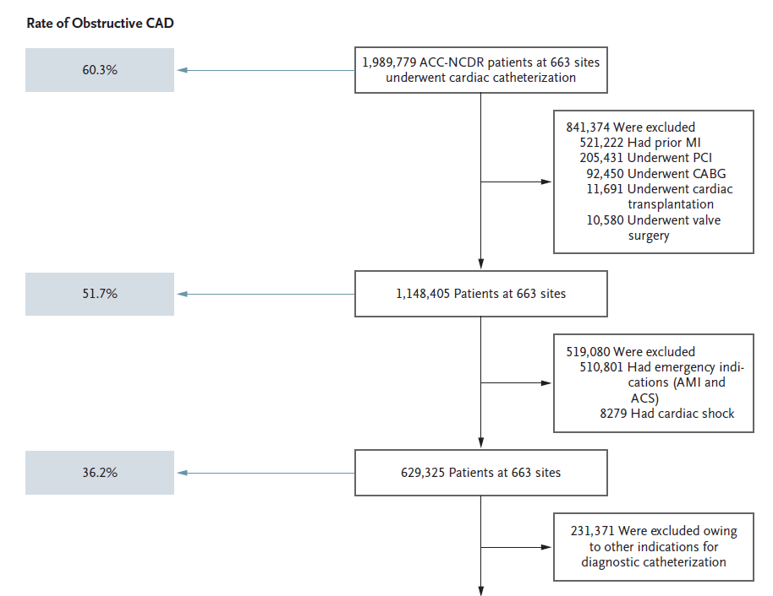
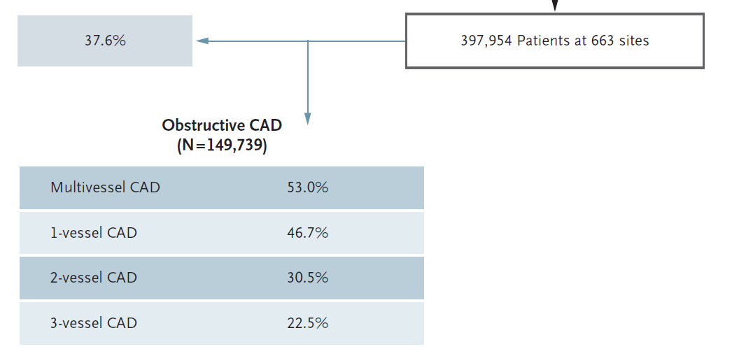
Población
Enero 2004-Abril 2008
Datos demográficos
Factores de riesgo clínicos
Síntomas (no angina,atipica,estable)
Test no invasivos
39.2% tienen coronarias
normales

Slide 4
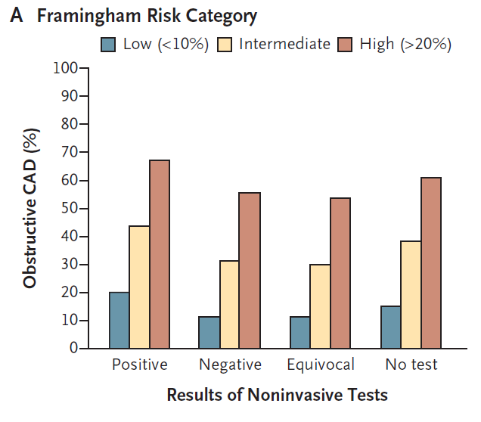
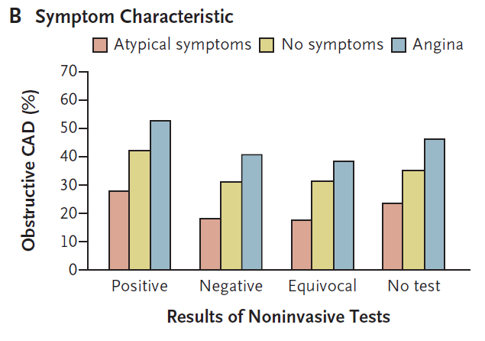
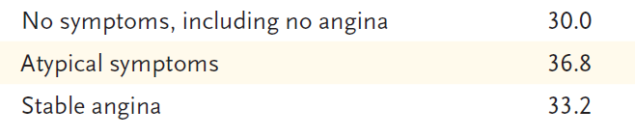
Resultados
Enfermedad Obstructiva Coronaria
41.0% 35%
OR 1.28
Realizados en 83.9%-68.6% posisitivos

Slide 5
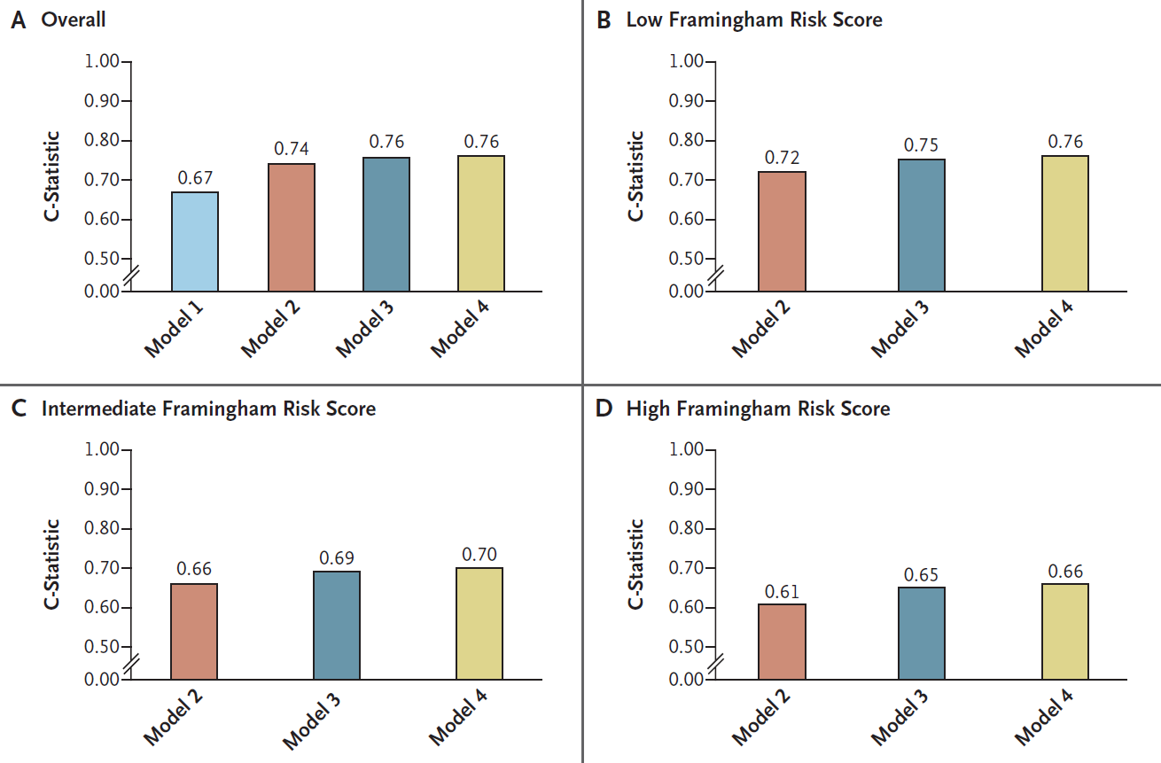
Resultados
(BMI,AP,ECV,EPOC,
Diálisis)
Factores
Clínicos
Síntomas
Test no invasivos

Slide 6
Reflexión
Solo algo más de ⅓ de pacientes sin enfermedad coronaria conocida tienen enfermedad obstructiva en la coronariografía
Las estrategias diagnósticas para indicación de coronariografía necesitan mejorar sustancialmente para aumentar el rendimiento diagnóstico de la angiografía coronaria
La habilidad de un test no invasivo para predecir enfermedad coronaria es limitada
Estudio PROMISE. NHI
Compara el AngioTAC coronario con test de estres funcional en 10.000 pacientes

Slide 7
Interacción IBP-Clopidogrel 2010
Estudio farmacocinético/dinámico
Estudio COGENT publicado.Randomizado
Metaanálisis
Estudios Retrospectivos
Consenso de expertos de AHA/ACCF/ACG

Slide 8
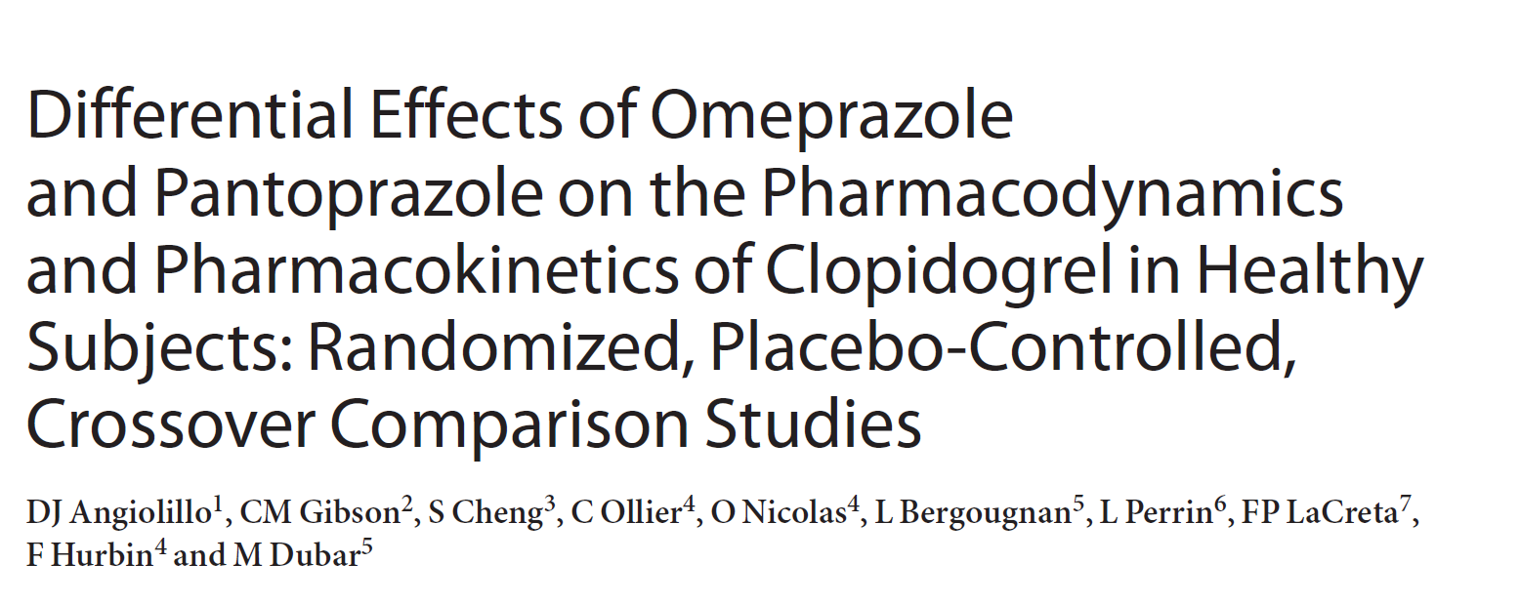

nature publishing group
15 de Septiembre 2010

Slide 9

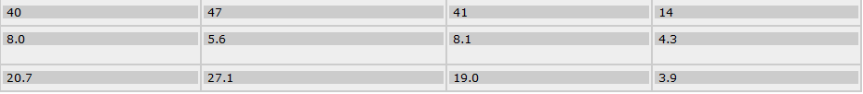
Estudio farmacocinético/dinámico

Slide 10
Standard-Dose Clopidogrel + Omeprazole Administered Together: Effect on Clopidogrel Active Metabolite H4
Mean (SD) Plasma Concentration of Clopidogrel Active Metabolite H4 After a 300-mg Loading Dose (Left) and 75-mg Maintenance Dose (Right)
60
Day 1 – 300 mg
25
Day 5 – 75 mg
50
Clopidogrel alone
20
Clopidogrel + omeprazole
Clopidogrel alone
40
LOQ = 0.500 ng/mL
Clopidogrel + omeprazole
15
LOQ = 0.500 ng/mL*
Mean (SD) Active Metabolite H4 Concentration (ng/mL)
Mean (SD) Active Metabolite H4 Concentration (ng/mL)
30
10
20
10
5
0
0
0.0
0.5
1.0
1.5
2.0
2.5
3.0
0.0
0.5
1.0
1.5
2.0
Nominal Time (h)
Nominal Time (h)
After coadministering omeprazole with clopidogrel (300-mg LD/75-mg/day MD), the clopidogrel active metabolite H4 pharmacokinetic parameters were consistently decreased by:
  46% on Day 1 (P<0.001) and 42% on Day 5 (P<0.001) for maximum plasma concentration (C_{max}), and
  45% on Day 1 (P<0.001) and 40% on Day 5 (P<0.001) for area under the concentration–time curve from time zero to 24 hours (AUC₀₋₂₄).
LD, loading dose; LOQ, lower limit of quantification.; MD, maintenance dose; SD, standard deviation.
Angiolillo DA, et al. Clin Pharmacol Ther. 2010 Sep 15. [Epub ahead of print]
4
Notes:
The pharmacokinetic population included 66 subjects.
Based on AUC₍₀₋₂₄₎ ratios (standard-dose clopidogrel + omeprazole vs standard-dose clopidogrel alone), the active metabolite H4 exposure was decreased by 45% following a 300-mg loading dose of clopidogrel given concomitantly with 80 mg omeprazole (AUC₀₋₂₄ ratio of 0.55; 90% CI, 0.51-0.59; P<0.001) and by 40% following an additional 4-day 75-mg maintenance dose of clopidogrel + omeprazole (AUC₀₋₂₄ ratio of 0.60; 90% CI, 0.56-0.65; P<0.001).
After a 300-mg clopidogrel loading dose given concomitantly with omeprazole, the C_{max} ratio was 0.54 (90% CI, 0.51-0.58; P<0.001); after an additional 4 days of clopidogrel 75 mg/day given concomitantly with omeprazole, the C_{max} ratio was 0.58 (90% CI, 0.53-0.65; P<0.001).
Simultaneous administration of a 300-mg clopidogrel loading dose with omeprazole increased exposure of unchanged clopidogrel (AUC₀₋₂₄ ratio, 1.19; 90% CI, 1.06-1.33; P=0.012), and after 4 days of clopidogrel 75 mg/day, unchanged clopidogrel exposure increased by 51% (AUC₀₋₂₄ ratio, 1.51; 90% CI, 1.35-1.69; P<0.001).
Reference
1. Angiolillo DA, et al. Clin Pharmacol Ther 2010; in press.

Slide 11
Standard-Dose Clopidogrel + Pantoprazole Administered Together: Effect on Clopidogrel Active Metabolite H4
Mean (SD) Plasma Concentration of Clopidogrel Active Metabolite H4 After a 300-mg Loading Dose (Left) and 75-mg Maintenance Dose (Right)
Day 1 – 300 mg
Day 5 – 75 mg
50
Clopidogrel alone
20
Clopidogrel alone
Clopidogrel + pantoprazole
Clopidogrel + pantoprazole
40
LOQ = 0.5 (ng/mL)
LOQ = 0.5 (ng/mL)
15
30
10
Mean (SD) Active Metabolite H4 Concentration (ng/mL)
Mean (SD) Active Metabolite H4 Concentration (ng/mL)
20
10
5
0
0
0.0
0.5
1.0
1.5
2.0
3.0
0.0
0.5
1.0
1.5
2.0
Nominal Time (hr)
Nominal Time (hr)
After coadministering pantoprazole with clopidogrel (300-mg LD/75-mg/day MD), the clopidogrel active metabolite H4 pharmacokinetic parameters were decreased by:
  24% on Day 1 (P<0.001) and 28% on Day 5 (P<0.001) for maximum plasma concentration (C_{max}), and
  20% on Day 1 (P<0.001) and 14% on Day 5 (P=0.001) for area under the concentration–time curve from time zero to 24 hours (AUC₀₋₂₄).
LD, loading dose; LOQ, lower limit of quantification.; MD, maintenance dose; SD, standard deviation.
11
Angiolillo DA, et al. Clin Pharmacol Ther. 2010 Sep 15. [Epub ahead of print]
Notes:
The pharmacokinetic population included 58 men.
Based on AUC₍₀₋₂₄₎ ratios (standard-dose clopidogrel + pantoprazole vs standard-dose clopidogrel alone), the active metabolite H4 exposure was decreased by 20% following a 300-mg loading dose of clopidogrel given concomitantly 80 mg pantoprazole (AUC₀₋₂₄ ratio of 0.80; 90% CI, 0.76-0.85; P<0.001) and by 14% following an additional 4-day 75-mg maintenance dose of clopidogrel + pantoprazole (AUC₀₋₂₄ ratio of 0.86; 90% CI, 0.79-0.93; P=0.002).
After a 300-mg clopidogrel loading dose given concomitantly with pantoprazole, the C_{max} ratio was 0.76 (90% CI, 0.70-0.82; P<0.001); after an additional 4 days of clopidogrel 75 mg/day given concomitantly with pantoprazole, the C_{max} ratio was 0.72 (90% CI, 0.65-0.79; P<0.001).
Simultaneous administration of a 300-mg clopidogrel loading dose with pantoprazole did not affect exposure of unchanged clopidogrel (AUC₀₋₂₄ ratio, 1.00; 90% CI, 0.90-1.10; P=0.942), but after 4 days of clopidogrel 75 mg/day, unchanged clopidogrel exposure increased by 19% (AUC₀₋₂₄ ratio, 1.19; 90% CI, 1.07-1.33; P=0.011).
Reference
1. Angiolillo DA, et al. Clin Pharmacol Ther 2010; in press.

Slide 12
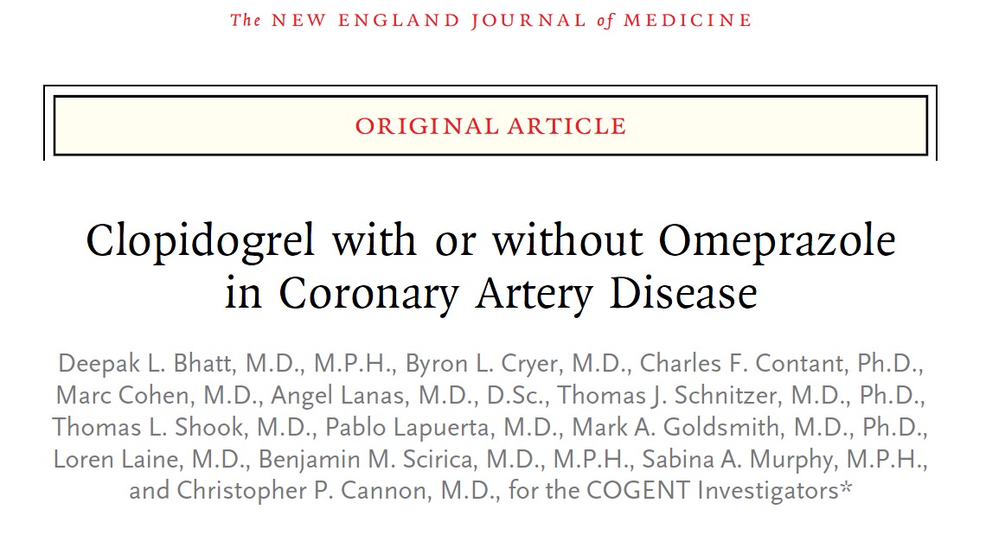

Estudio COGENT

Slide 13
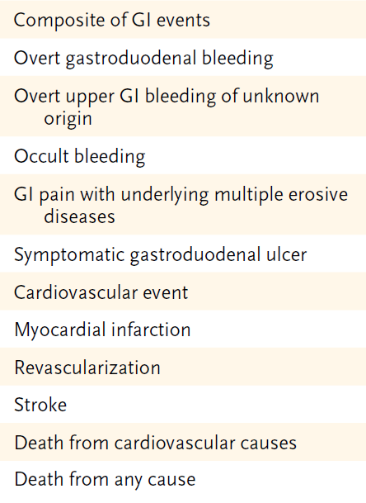
ESTUDIO COGENT
Multicentrico, internacional ramdomizado, doble ciego, placebo controlado. Eficacia y seguridad de CGT-2186, una dosis combinada fija de 75 mgrs de Clopidogrel y Omeprazol 20 mgrs, comparado con Clopidogrel “Omeprazol retardado”
Pacientes con SCA
Implantación de un STENT
3761 pacientes (se pensaba reclutar 5000 pacientes)
Seguimiento medio 106 días (maximo 341 días)

Slide 14
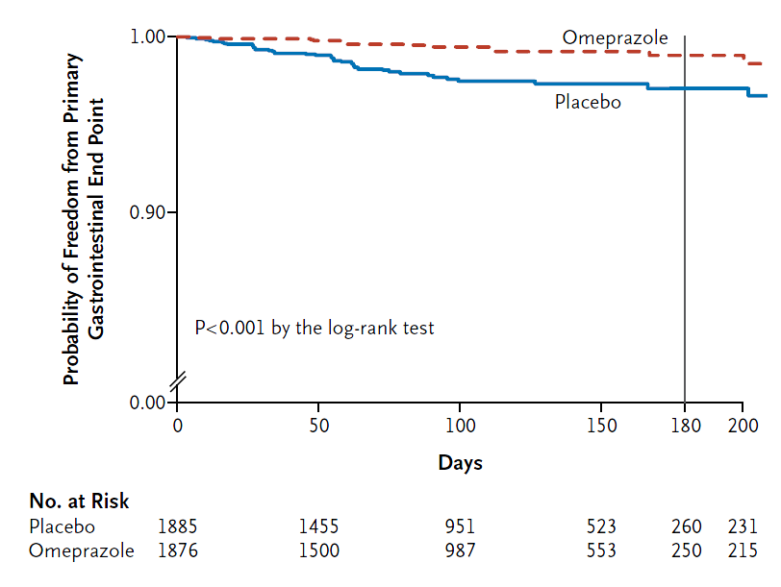
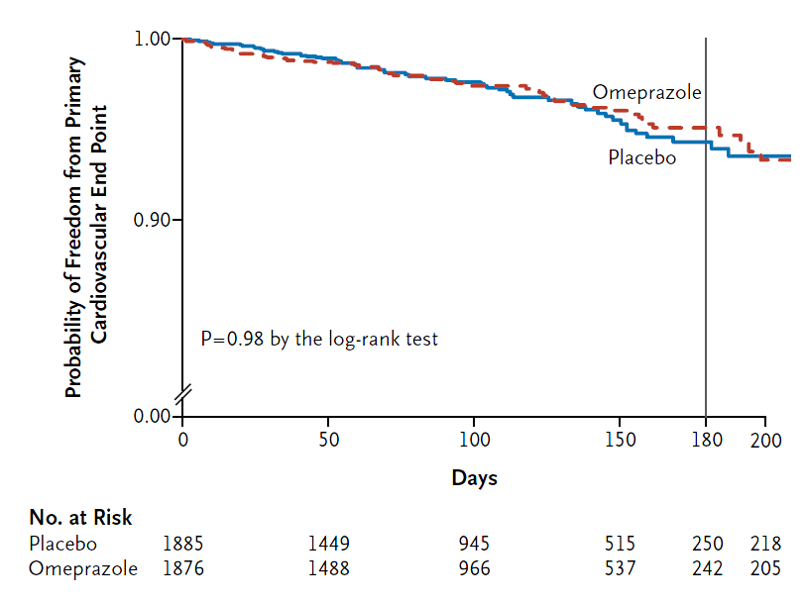
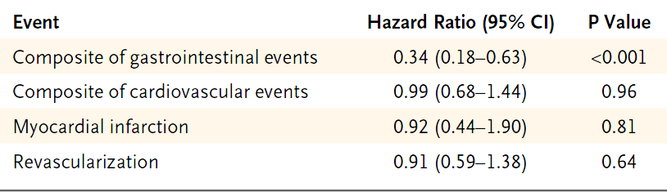
Estudio COGENT
1.1%
4.9%
2.9%
5.7%

Slide 15
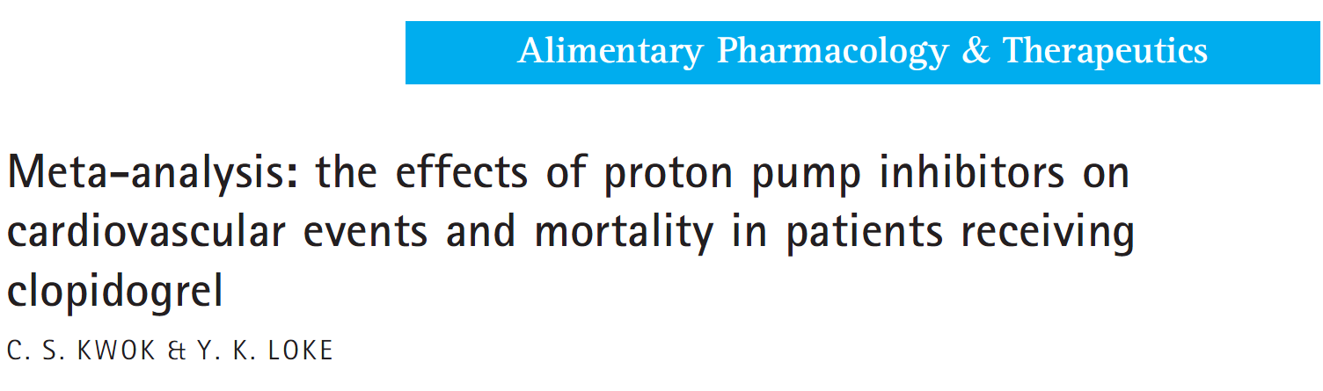
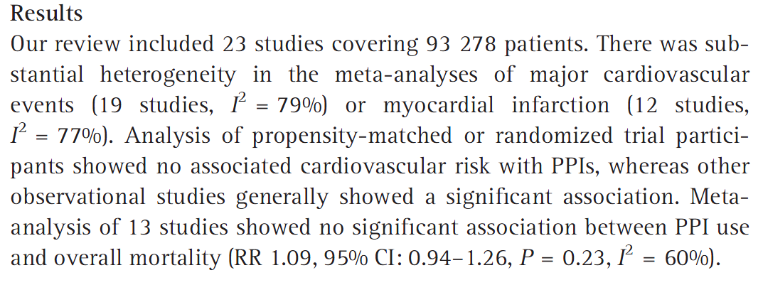
Metaanálisis
Abril 2010

Slide 16
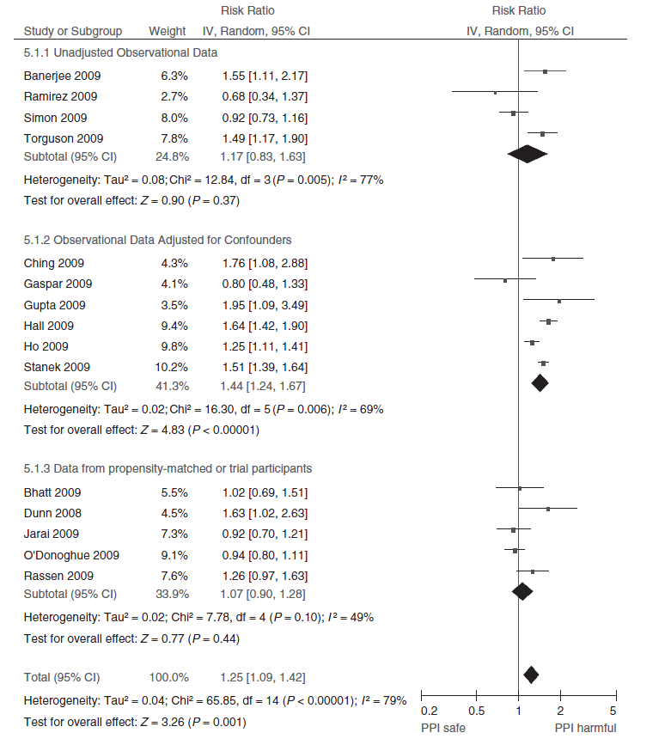
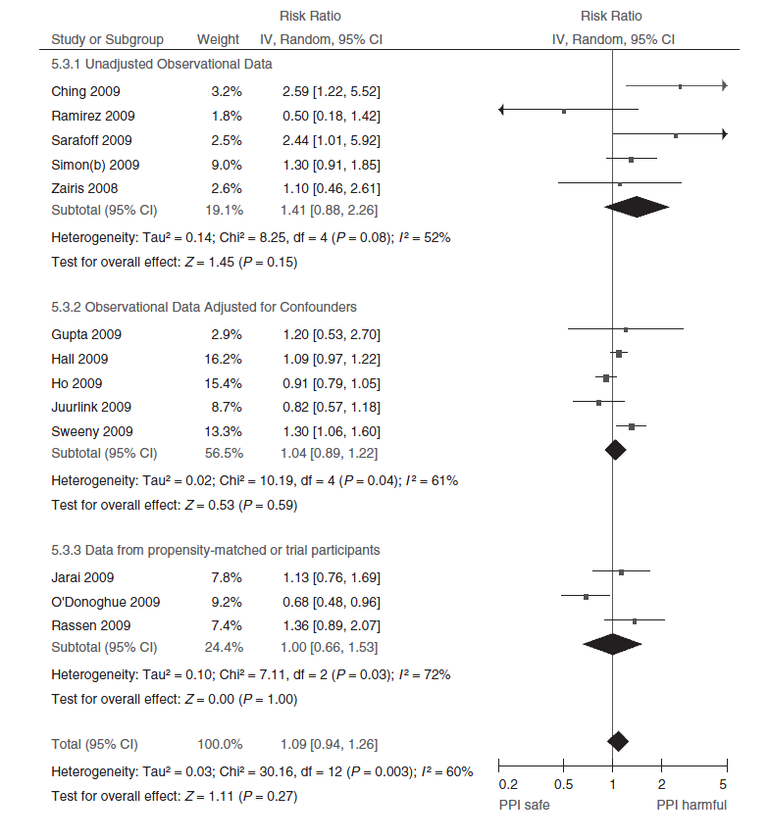
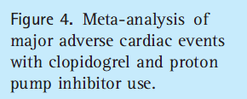
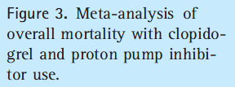
Metaanálisis

Slide 17
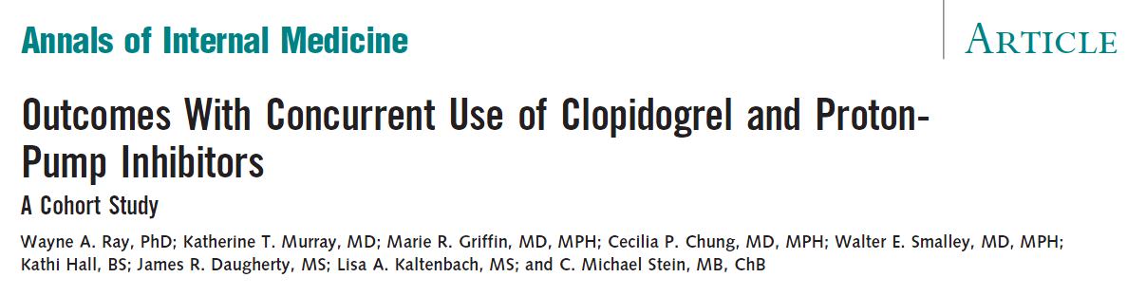
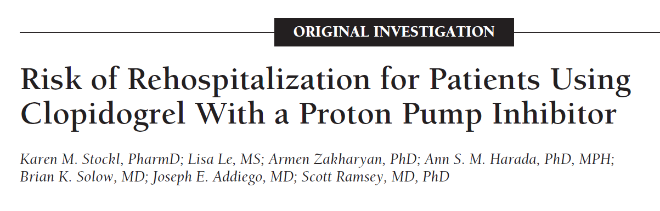
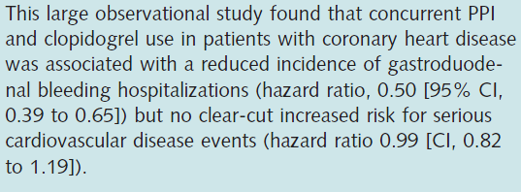
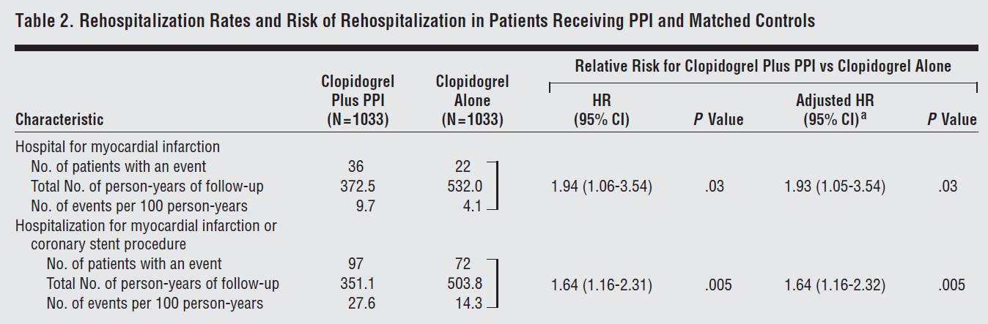
Estudios Retrospectivos
2010;152:337-345.
.
Arch Intern Med. 2010;170(8):704-710

Slide 18
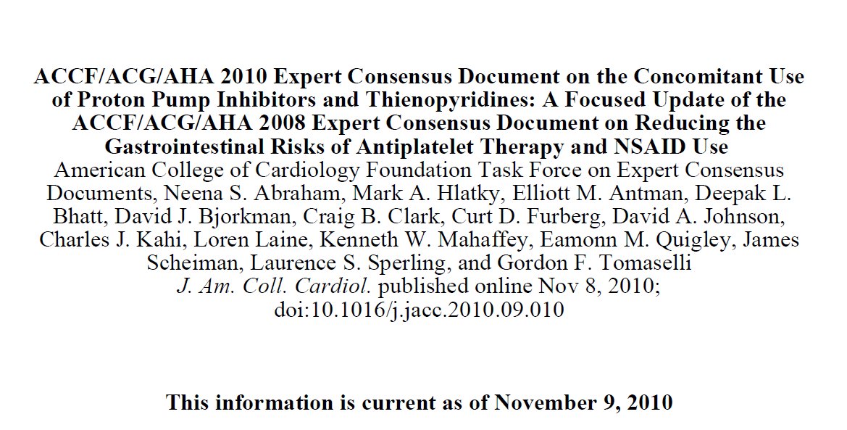

Slide 19
Conclusiones
La reducción de riesgo de sangrado con IBP en pacientes con factores de riesgo GI y DAPT es sustancial,y tiene mayor peso que la potencial reducción de eficacia cardiovascular de la interacción
Se deben de usar en pacientes con los siguientes factores de riesgo GI de sangrado (decisión individualizada no de rutina a todos los pacientes)
-Sangrado GI previo
-Edad avanzada
-Uso concomitante de ACO,AINES,Esteroides
-Infección por helicobacter pylori
-“Reduccion de síntomas gastroinestinales” (dispepsia)
IBP=Inhibidor Bomba de Protones DAPT=Doble Antigregacion Plaquetaria

Slide 20
Conclusiones
Existe una base farmacodinámica-farmacocinética de la interacción,pero el significado clínico es dudoso
La magnitud de la interacción en estudios observacionales es pequeña (HR o OR <2) y puede se debida a la prescripción de los IBP a los pacientes de mayor riesgo cardiovascular
- Puede que el PANTOPRAZOL tenga menor interacción que el OMEPRAZOL (Estudio SPICE NCT 00930670 )
-Los IBP son superiores a AntiH2,pero la Ranitidina puede ser una alternativa en riesgo de sangrado bajo y reflujo gastroesofágico no refractario
IBP=Inhibidor Bomba de Protones DAPT=Doble Antigregacion Plaquetaria

Slide 21
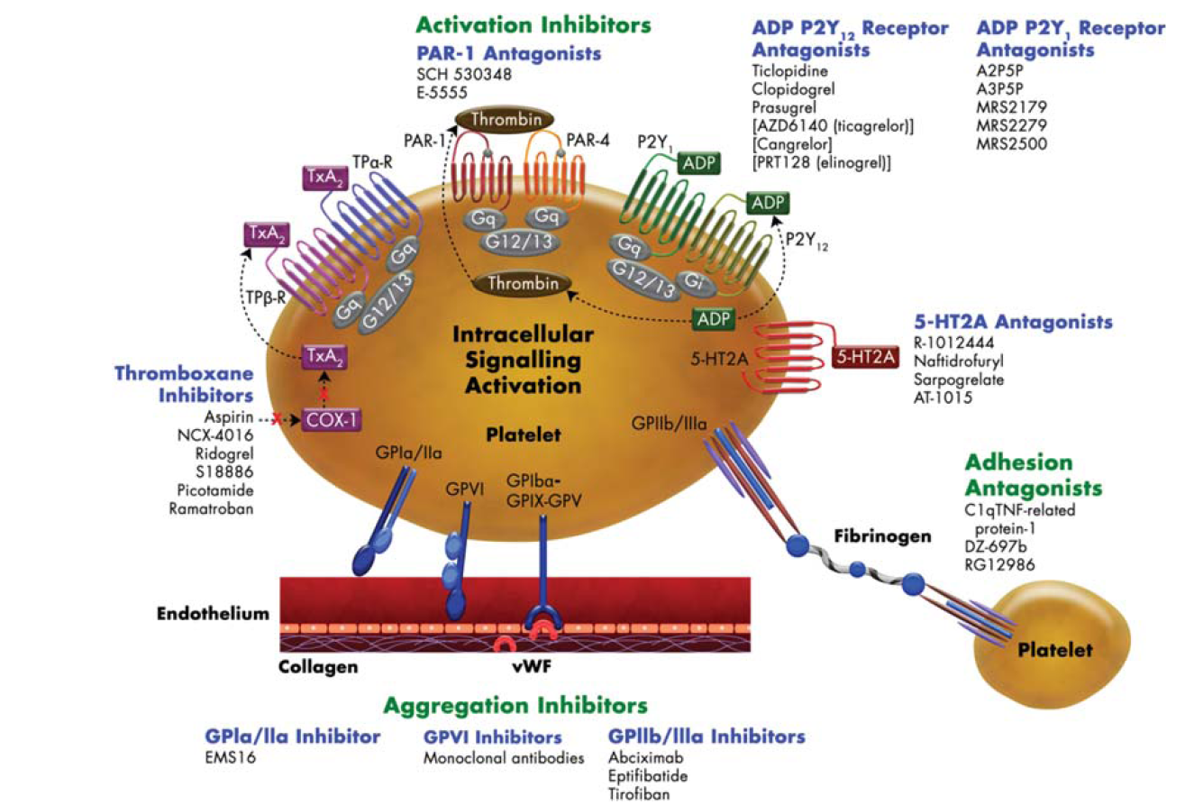
Antiagregantes Plaquetarios
Vorapaxar
Atopaxar

Slide 22
Inhibidores de P2Y12
Ticlopidina
Clopidogrel
Prasugrel
Ticagrelor
Cangrelor
Elinogrel

Slide 23
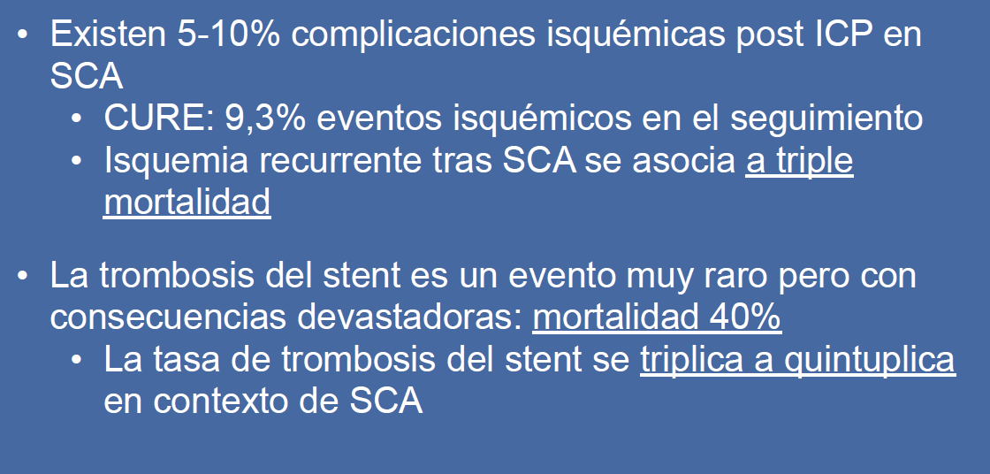
LIMITACIONES CLOPIDOGREL
  Retraso en el inicio de acción
  Variabilidad individual de respuesta plaquetaria
      Variantes CYP2C19
      Otros Polimorfismos:
a) ABCB1
b) Otras isoenzimas CYP
c) Receptor P2Y12
  Irreversibilidad del efecto antiplaquetario

Slide 24
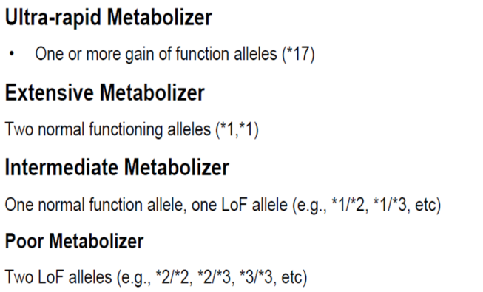
Genetic Factors
Polymorphisms of CYP
Polymorphisms of GPIa
Polymorphisms of P2Y₁₂
Polymorphisms of GPIIIa
2C19
FDA Box Warnings
Clopidogrel Response Variability
FDA Drug Safety Communication: reduced effectiveness of Plavix
(clopidogrel) in patients who are poor metabolizers of the drug.Marzo 2010
Clinical Factors
Failure to prescribe/Poor compliance
Under-dosing
Poor absorption
Drug-drug interactions
Acute coronary syndrome
Diabetes Mellitus/Insulin resistance
Elevated body mass index
Cellular Factors
Accelerated platelet turnover
Reduced CYP3A metabolic activity
Increased ADP exposure
Up-regulation of the P2Y₁₂ pathway
Up-regulation of the P2Y₁ pathway
Up-regulation of P2Y–independent pathways
(collagen, epinephrine, TXA₂, thrombin)
Angiolillo DJ et al. J Am Coll Cardiol 2007
Notes:
24

Slide 25
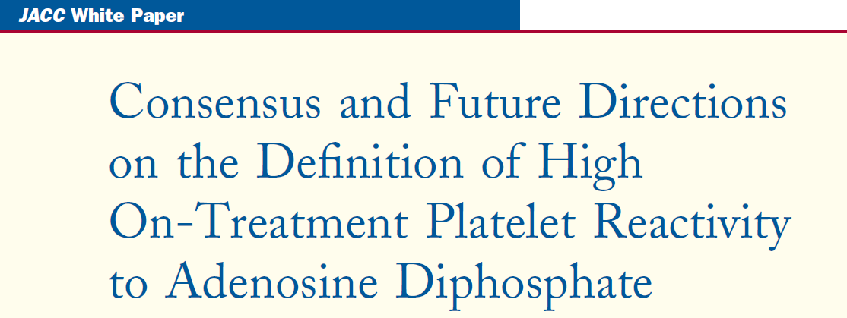

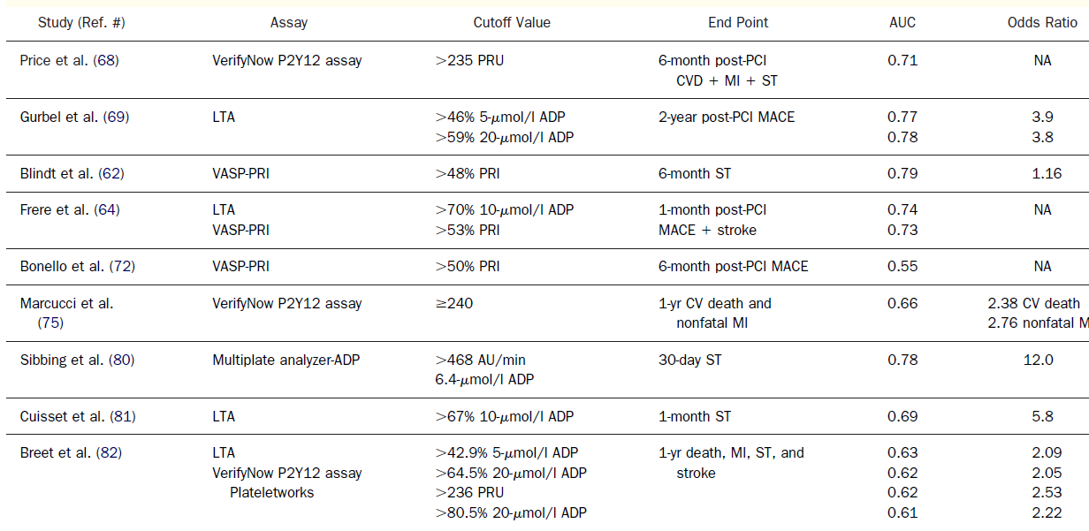

Slide 26
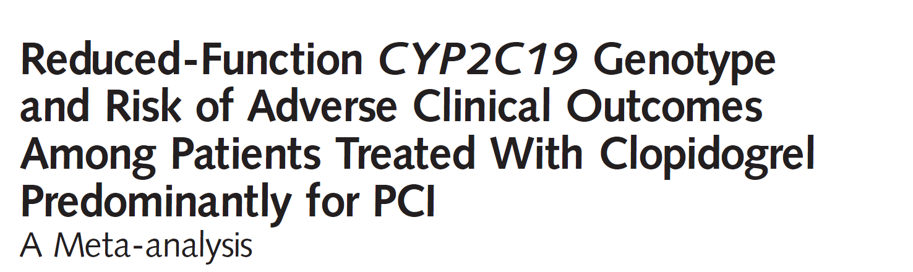


Slide 27
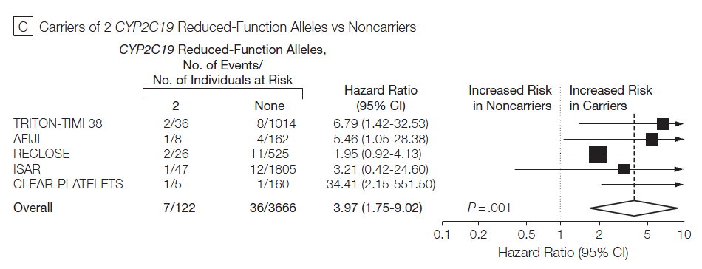
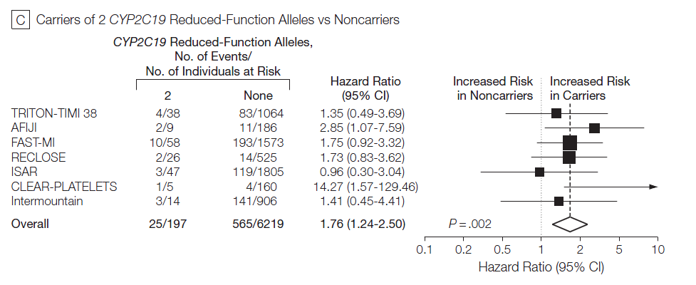
Resultados
Muerte Cardiovascular,Infarto de Miocardio,ACVA

Slide 28
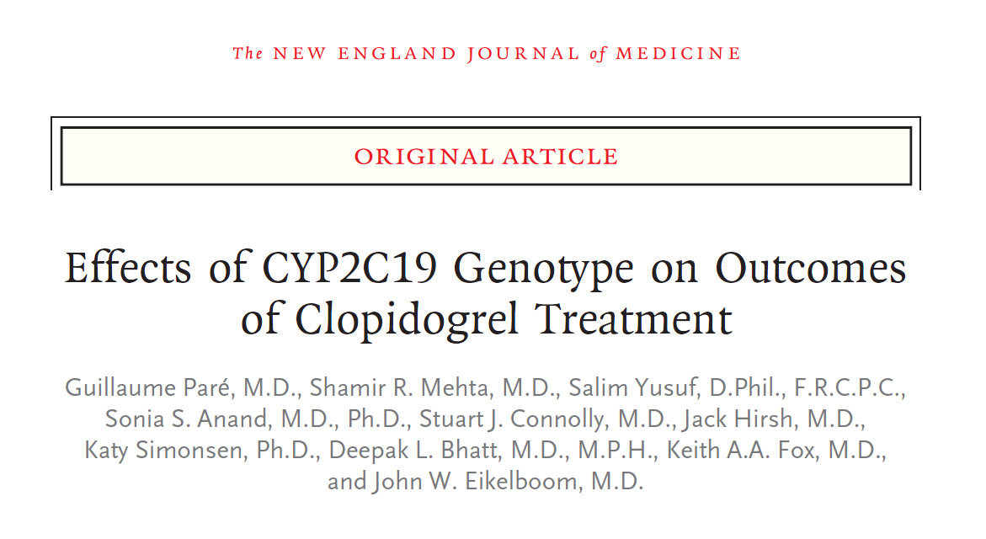
Estudios CURE ACTIVE
NEJM 2010;363:1704-14

Slide 29
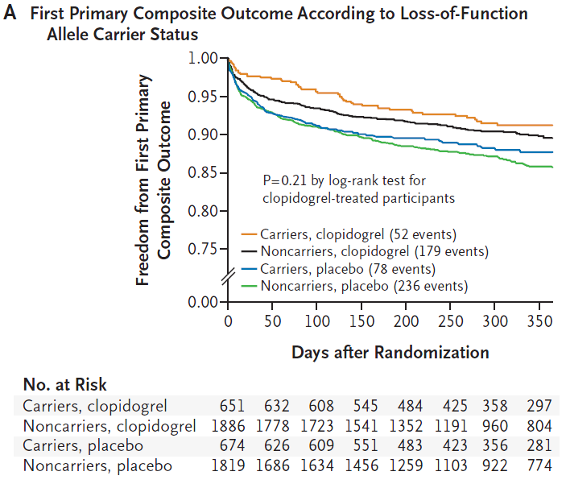
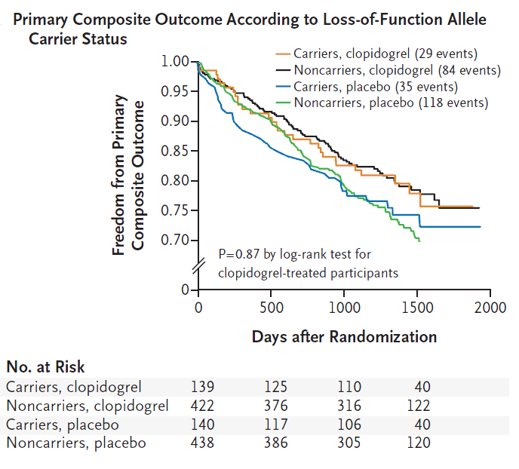
Estudios CURE-ACTIVE
CURE
ACTIVE

Slide 30
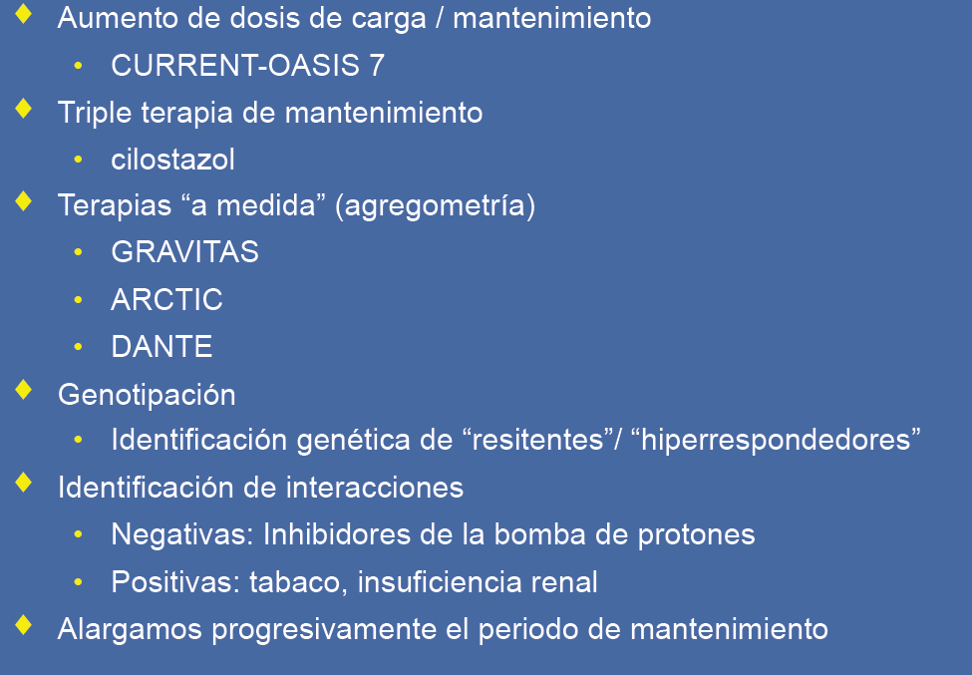
Nuevas Estrategias con Clopidogrel
Lancet 2010;376:1233-43
NEJM 2010;363:930-42
CILON-T Late Breaking Trial ACC 2010-JACC 2011;57:280-9
Usar otros bloqueantes
del P2Y12

Slide 31
GRAVITAS Study Design Presentado AHA 16-Nov-2010
Elective or Urgent PCI with DES*
VerifyNow P2Y12 Test 12-24 hours post-PCI
PRU ≥ 230
R
High-Dose Clopidogrel†
clopidogrel 600-mg, then
clopidogrel 150-mg daily X 6 months
Standard-Dose Clopidogrel†
clopidogrel 75-mg daily X 6 months
Primary Efficacy Endpoint: CV Death, Non-Fatal MI, Stent Thrombosis at 6 mo
Key Safety Endpoint: GUSTO Moderate or Severe Bleeding at 6 mo
Pharmacodynamics: Repeat VerifyNow P2Y12 at 1 and 6 months
*Peri-PCI clopidogrel per protocol-mandated criteria to ensure steady-state at 12-24 hrs
†placebo-controlled
All patients received aspirin (81-162mg daily)
Notes:
GRAVITAS enrolled patients undergoing elective or urgent PCI with a drug-eluting stent. Clopidogrel-naïve patients had to receive a 600-mg loading dose, and those already on chronic clopidogrel could not receive an additional load. This was designed to ensure that the effect of clopidogrel was at steady-state at the time of platelet function measurement.
Platelet function was measured with the VerifyNow P2Y12 test 12 to 24 hours after PCI. With this test, platelet reactivity is reported in terms of PRU – the higher the PRU, the greater the level of residual reactivity on clopidogrel.
In GRAVITAS, high reactivity was defined as a PRU greater than or equal to 230, a cutoff similar to that suggested by previous studies to provide the maximal sensitivity and specificity for subsequent cardiac events.
Patients with high reactivity were randomized in a double-blind fashion to either 6 months of high dose clopidogrel or standard dose clopidogrel.
The primary efficacy endpoint was a composite of cardiovascular death, non-fatal MI, or stent thrombosis at 6-months.
The Key safety endpoint was GUSTO severe or moderate bleeding.
Platelet reactivity was re-assessed at 30-days and 6 months in a blinded fashion, but no treatment decisions were made based upon the results of these tests.

Slide 32
GRAVITAS Patient Flow
5429 patients screened with VerifyNow P2Y12
12-24 hours post-PCI
2214 (41%) with high residual platelet reactivity
(PRU ≥ 230)
3215 (59%) without high residual platelet reactivity
(PRU < 230)
Clopidogrel
High Dose
N=1109
Clopidogrel
Standard Dose
N=1105
Notes:
We screened 5,429 patients with the VerifyNow test -- the largest cohort of patients to ever undergo platelet function testing in a single study.
41% of patients were categorized as having high residual reactivity, and these
2,214 patients were randomly assigned to study drug.

Slide 33
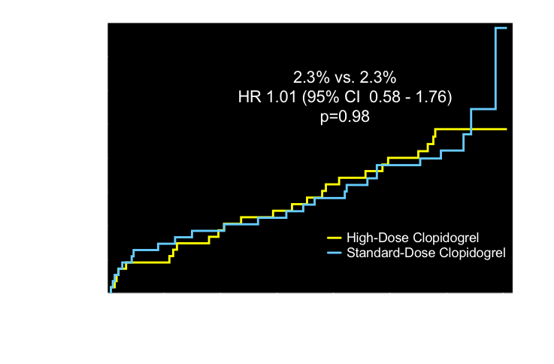
Primary Endpoint: CV Death, MI, Stent Thrombosis
Observed event rates are listed; P value by log rank test.
Notes:
Here are the primary results of the GRAVITAS trial.
The observed rate of the cardiovascular death, non-fatal MI, or stent thrombois was 2.3% in the high-dose group compared with 2.3% in the standard dose group, resulting in a hazard ratio of 1.01 and a p value of 0.98. There were a total of 50 events which was lower than the 68 that we had anticipated.

Slide 34
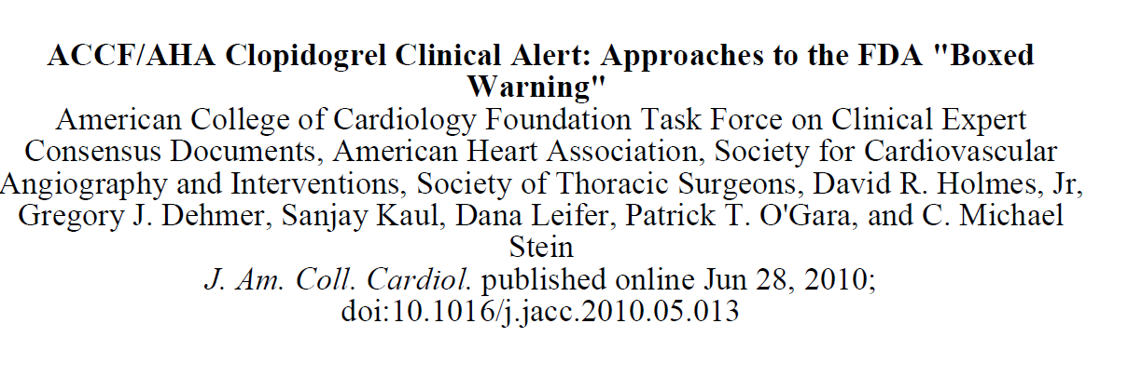
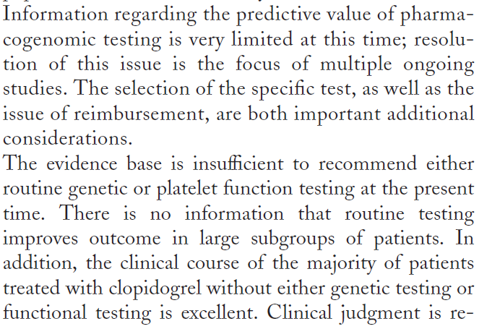

Slide 35
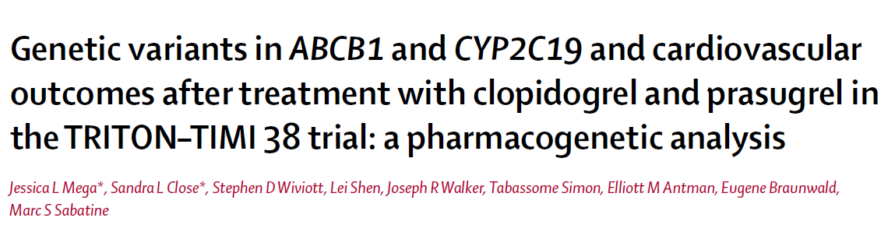
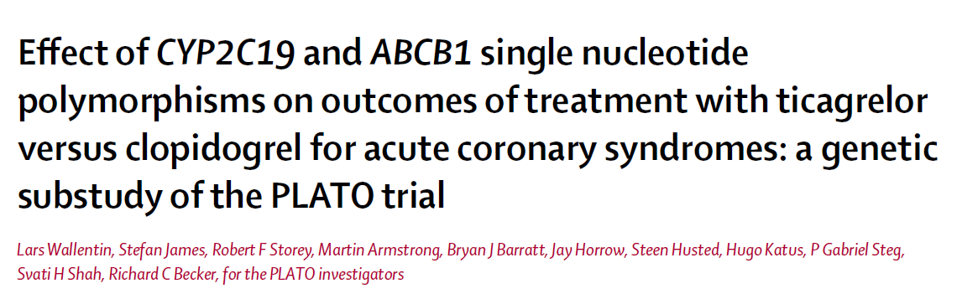
Prasugrel y Ticagrelor

Slide 36
¿Qué hacemos?
En la actualidad no debemos guiar terapias por estudios genéticos o test de función plaquetar
- El genotipo tiene valor en situaciones de SCA y PCI
El Clopidogrel no parece probable que desaparezca a medio plazo
Utilizaremos “Prasugrel” *en determinados subgrupos de riesgo
Valorar el beneficio neto es lo mas importante.
Tendremos que medir el coste eficacia de identificar “no respondedores” y de introducir nuevos farmacos
Utilizaremos las Guias
* Aprobado en la Actualidad

Slide 37
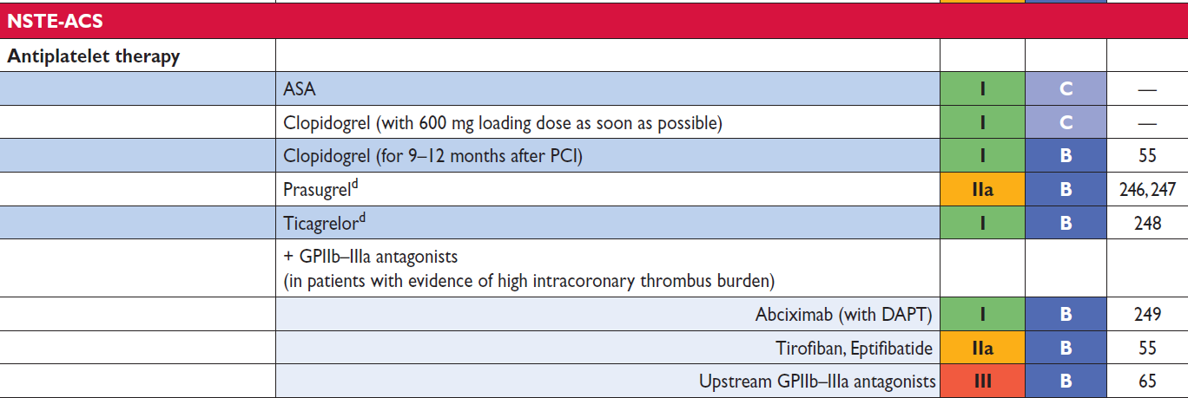

IIB-IIIA
SCASEST
EHJ 2010
Estudio ISAR-REACT 2
Estudio EARLY-ACS

Slide 38

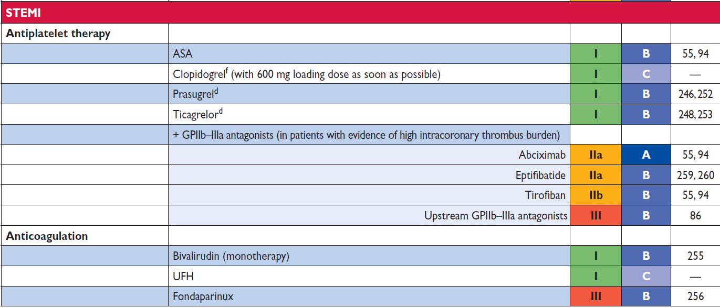
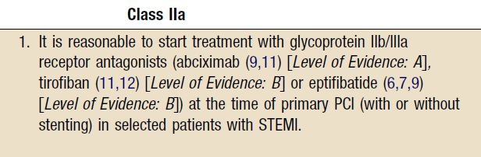
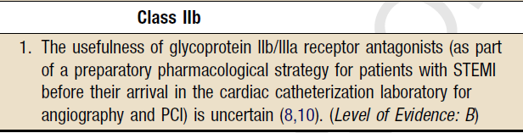
IIB-IIIA
SCACEST
FINESSE ON TIME 2

Slide 39
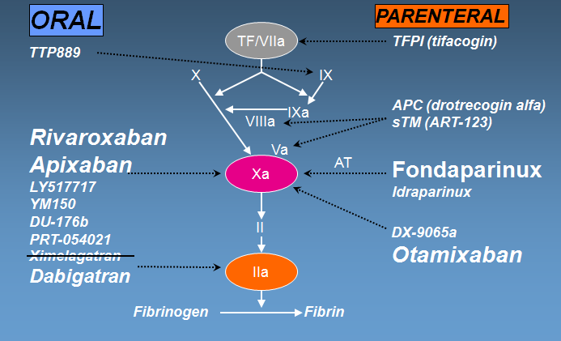
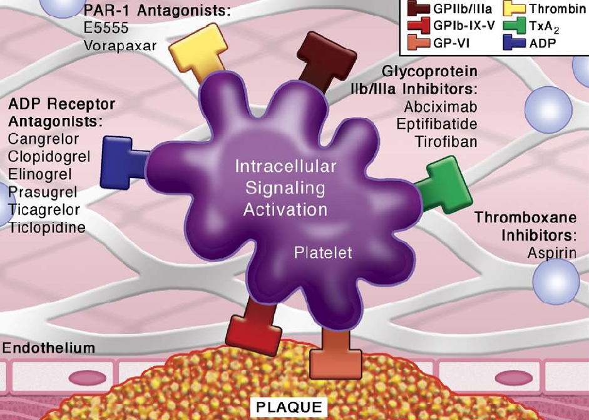

El Tercer Fármaco
Atopaxar
SCH 530348 -Vorapaxar
TRA-PCI
Rivaxobaran Fase III en SCA

Slide 40
Estudio LANCELOT-ACS
n = 603
Subjects with ACS
(Unstable angina or NSTEMI)
Randomization within 72 hours of symptom onset
Randomize
1:1:1:1
Double-blind
Placebo
QD
Atopaxar
400mg LD,
50mg QD
Atopaxar
400mg LD,
100mg QD
Atopaxar
400mg LD,
200mg QD
12 Weeks Active Treatment, 4 Weeks Follow-Up
Primary Endpoint:
Major bleeding (CURE) at 12 weeks
ESC 2010
Notes:
40

Slide 41
Incidencia de sangrado CURE
5.8%
P trend = 0.81
3.1%
2.2%
2.1%
1.3%
n=138
n=153
n=156
n=146
n=455
Relative Risk (95% CI) vs. placebo
RR 1.42 (0.44-4.8)
P = 0.63
RR 0.60 (0.11-3.00)
P = 0.62
RR 2.65 (0.78-10.3)
P = 0.13
RR 0.95 (0.18-5.04)
P = 0.99

Slide 42
Incidence of Holter-Detected Ischemia at
48 Hours following 400mg Loading Dose
RR 0.67 (95% CI 0.48-0.94)
P = 0.02
n=128
n=433
Placebo
Active combined
atopaxar

Slide 43
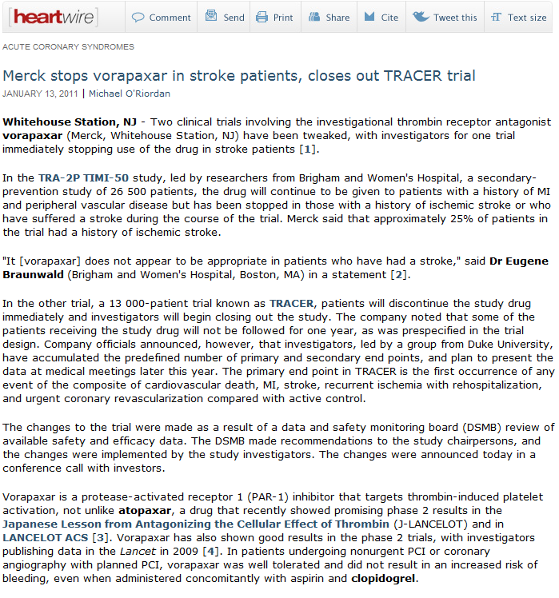
El Tercer Fármaco

Slide 44
En 5 lineas
-Alopurinol a altas dosis para tratamiento de angina estable Lancet 2010;375:2161-67
-Testing of Low-Risk Patients Presenting to the Emergency Department With Chest Pain. A Scientific Statement From the American Heart Association Circulation 2010;122:756-776
-Estudio ARMYDA 4 RELOAD European Heart Journal 2010;31:1337-43
-Estudio FRANCIS ACS. Varespladib Inhibición de sPLA2
JACC 2010;56:1079-88
-A Risk Score to Predict Bleeding in Patients With Acute Coronary Syndromes JACC 2010 ;55:2556-66

Slide 45



ACUITY HORIZONS AMI
JACC 2010 ;55:2556-66

Slide 46

ACUITY HORIZONS AMI
JACC 2010 ;55:2556-66

Slide 47

Muchas Gracias por su Atención
“Aquel que salva una vida,
contribuye a salvar
el mundo”
Talmud
“La vida se nos dá y la merecemos dándola”
R Tagore

